Slide 1
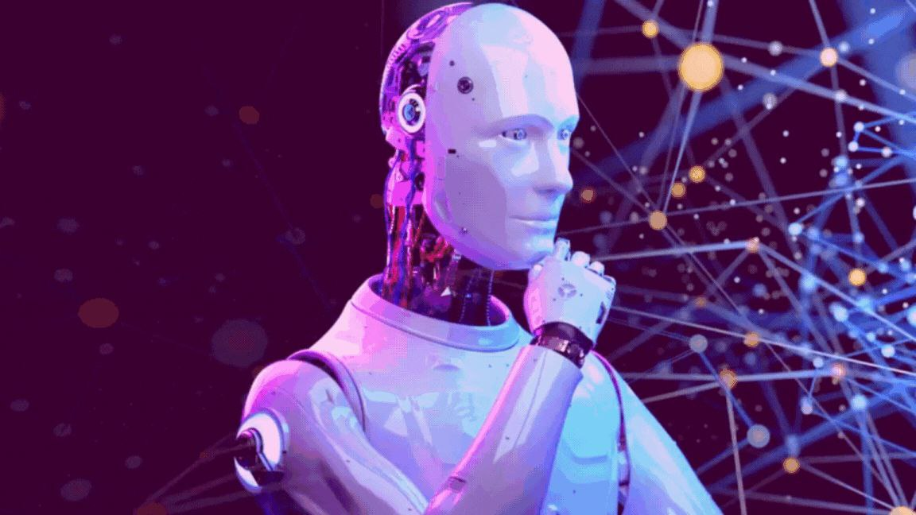
What is AI?

Slide 2


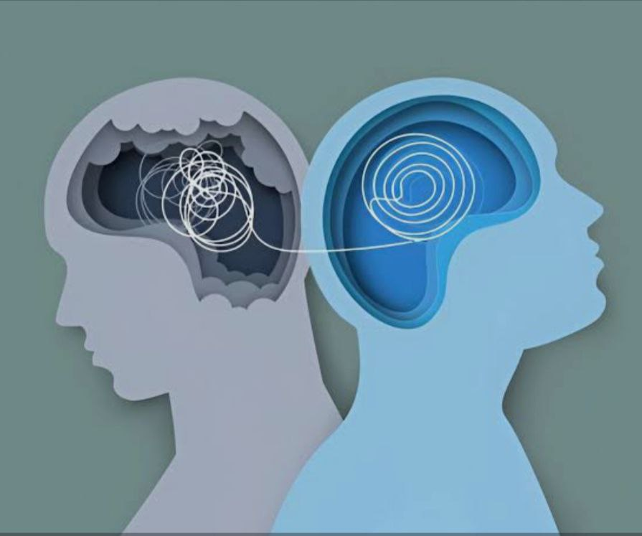
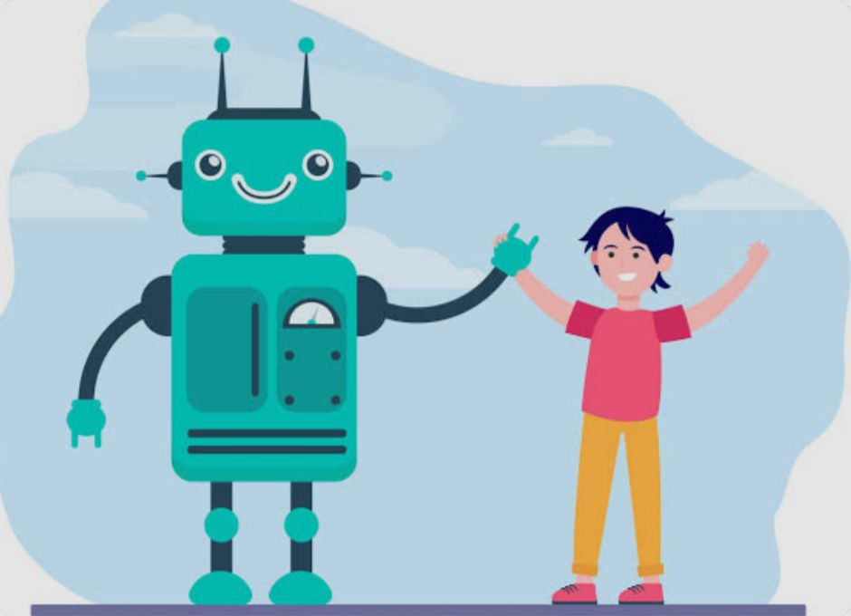

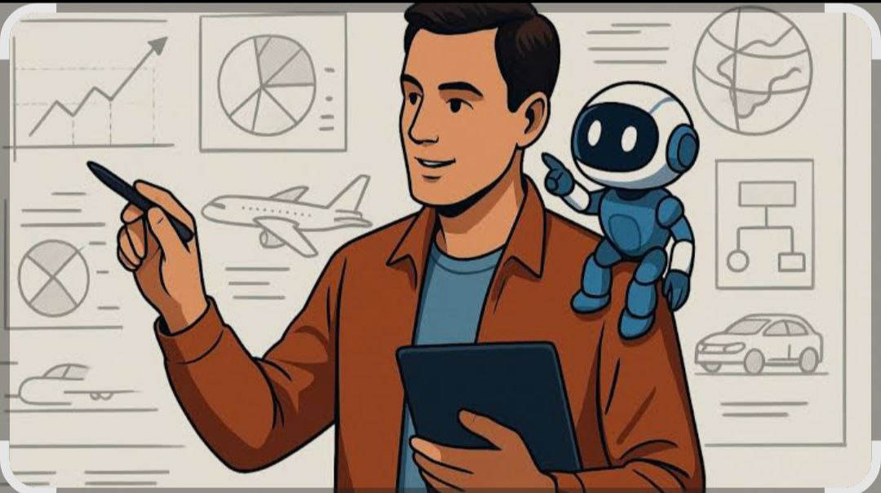
AI

Slide 3


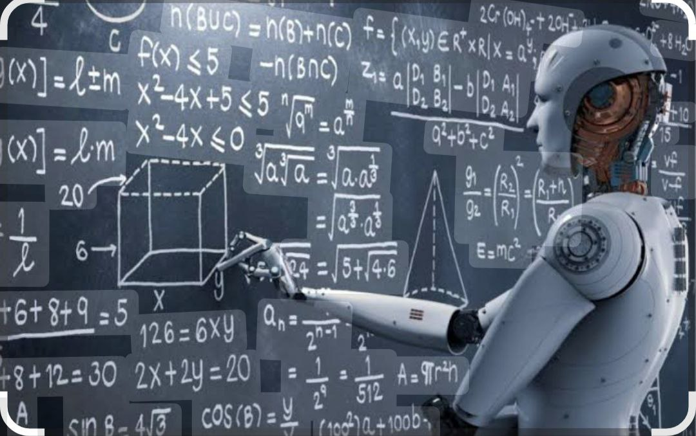

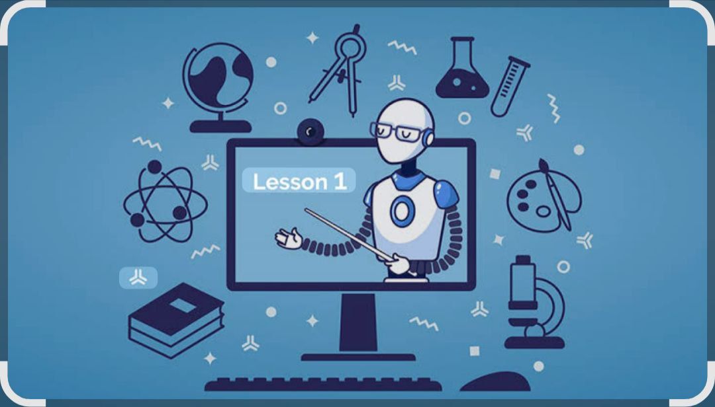
Artificial Intelligence in Education

Slide 4
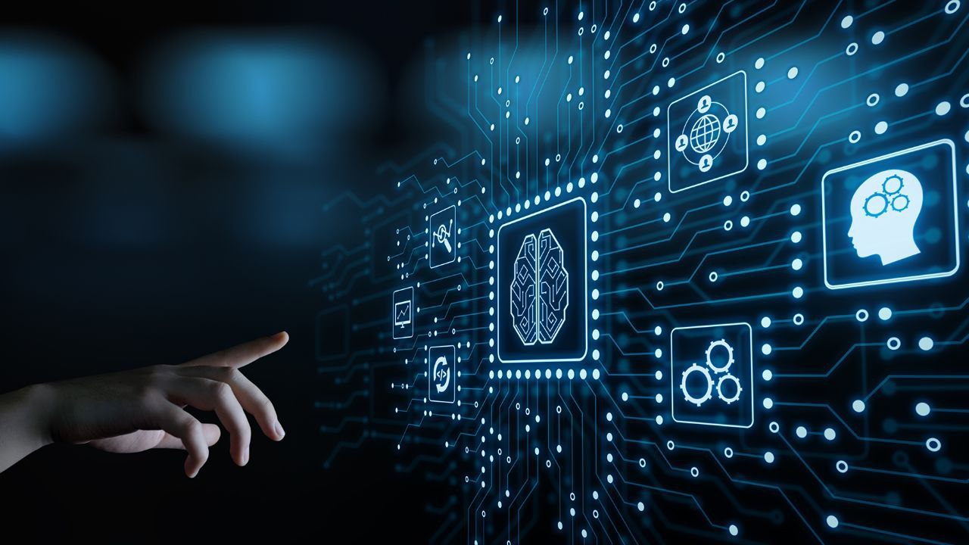
It explains everything clearly
Simplifies complex topics
Solves problems step by step

Slide 5
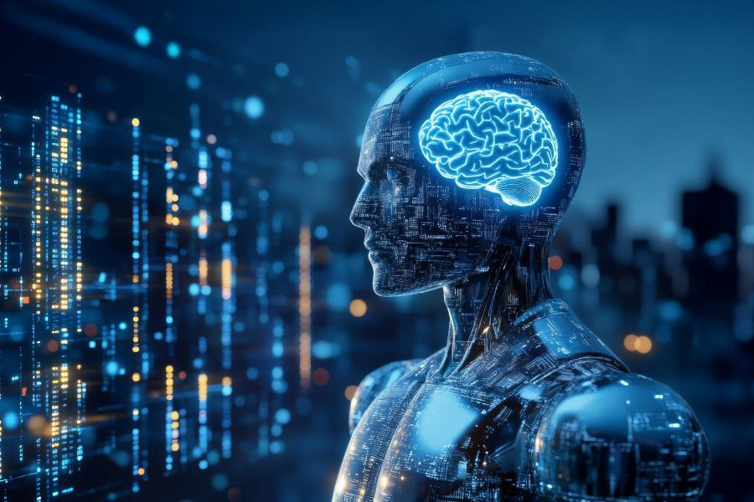



SUPPORTING APPLICATIONS

Slide 6
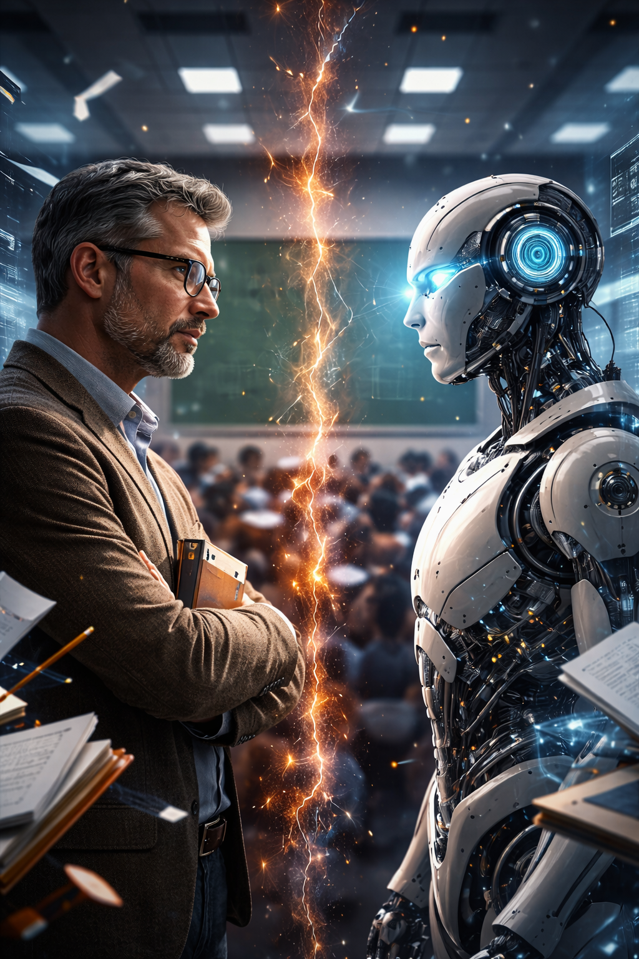
Now, let’s compare AI with teachers, and find out whether it can replace them

Slide 7
AI vs Teachers
Artificial intelligence
Teachers
Accesses vast, up-to-date information instantly
Excellent at retrieval, summarization, pattern detection
Consistency: same answer every time (unless updated)
Strong logical reasoning and structured explanations
Works best with well-defined problems
Lacks true understanding or lived experience
Scales personalization to millions
Adapts pace, difficulty, and format instantly
No fatigue or bias from mood or workload
Bottom line:
AI is a tool that delivers knowledge.
Knowledge is contextual, curated, and experience-based
Can prioritize what matters for a specific group
Teach why something matters, not just what it is
Understand misconceptions, confusion, and learning gaps
Adapt explanations based on student reactions
Use analogies grounded in real life
Personalize through human judgment and intuition
Limited by class size and time
Bottom line:
Teachers are the guides who turn knowledge into wisdom.

Slide 8

Artificial In

